Slide 1


Slide 2
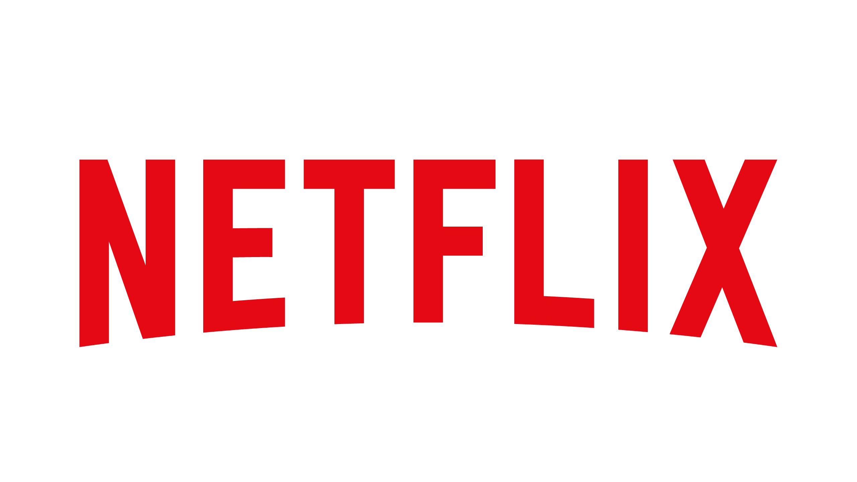








Who’s watching?
AI
Medium
Maddie
Bryce
Emma
Babik
MANAGE PROFILES

Slide 3
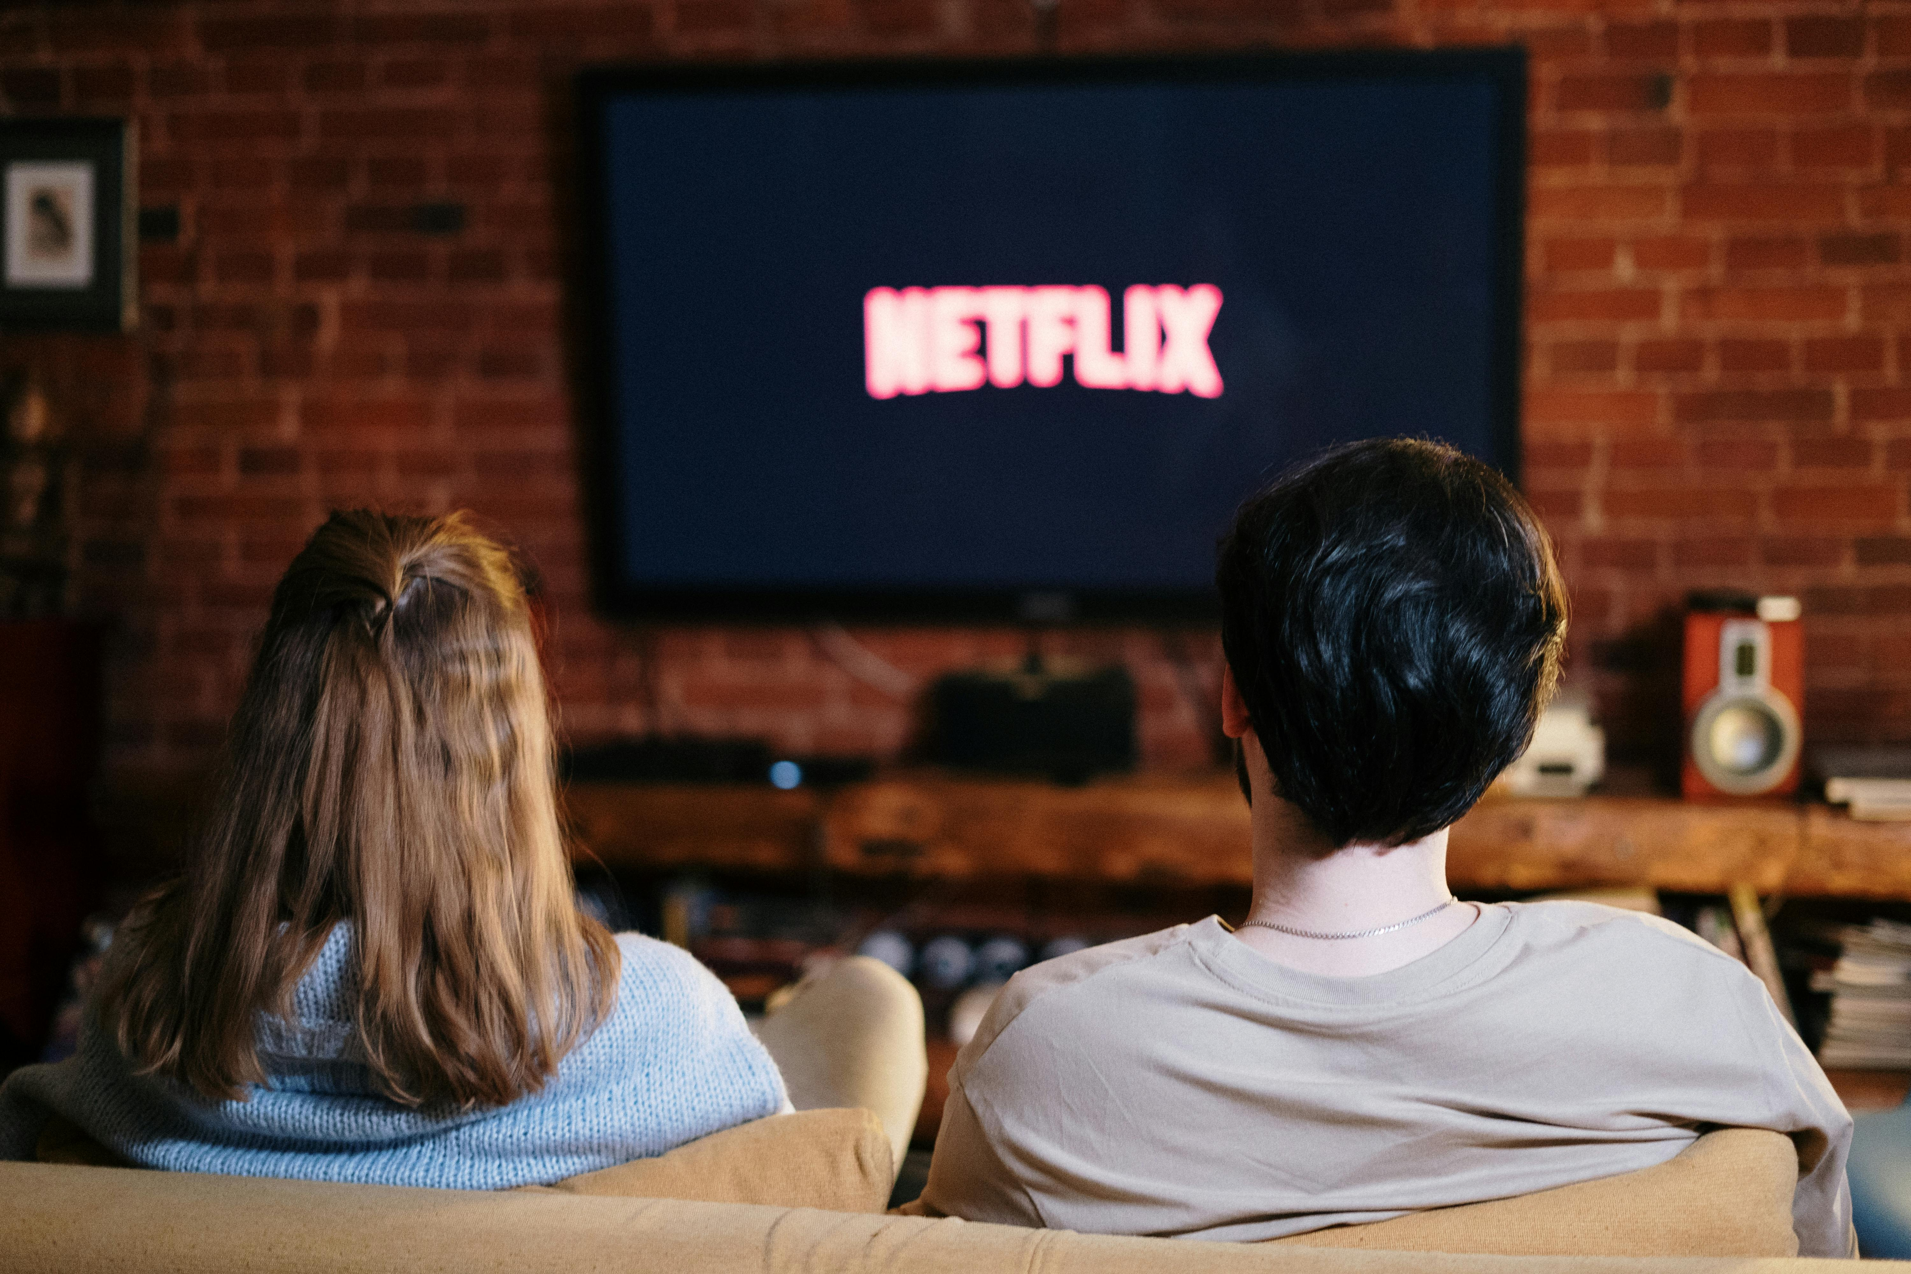
Netflix Through McLuhan
Netflix is not just entertainment; its format changes how we watch, think, and connect with others.
Example: Instead of waiting a week for one TV episode, Netflix releases full seasons at once.
Encourages binge-watching, keeps viewers glued to the screen longer
Creates shared online discussions where everyone reacts at the same time.

Slide 4
Key McLuhan Concepts
“The medium is the message” (Understanding Media).
Media shape society more than content.
“Hot media… are low in participation” (Understanding Media).
Hot = high definition, low participation
Cool = low definition, high participation
Global Village
Electronic media collapses distance and connects cultures.

Slide 5
Netflix as a Medium
Binge-watching norm
Personalized viewing
Global content circulation
Cultural Features
Auto-play and binge releases
Algorithms & recommendations
On-demand streaming
Technical Features

Slide 6
Applying McLuhan
Netflix’s Message
Continuous consumption
Individualized viewing
Algorithm-shaped choice
Hot or Cool?
Mostly hot (HD, passive viewing)
Some cool elements (user choice, feedback)
Tetrad
Enhances: Convenience, immersion
Obsolesces: TV schedules
Retrieves: Serialized storytelling
Reverses: Attention fatigue, loss of control

Slide 7
Implications
Societal Impact
Changes attention habits
Reduces shared viewing experiences
Ethical / Future Issues
Data tracking & privacy
Algorithmic bias
Corporate control of culture
Scholarly Sources
https://quod.lib.umich.edu/m/mij/15031809.0002.206/--tv-got-better-netflixs-original-programming-strategies?rgn=main;view=fulltext
https://marissapeloso.wordpress.com/2017/11/07/netflix-tetrad-of-media-effects/

